Slide 1
Footstep Power Generator
Group Members:
1) Digvijay V. Ahirrao (Roll No. 01)
2) Amit V. Kamble (Roll No. 28)
3) Prashant M. Mishra (Roll No. 40)
4) Saurabh P. Parab (Roll No. 43)
Under the Guidance of:
Prof. J. P. Patil

Slide 2
Introduction
This Footstep Power Generation System is used to generate voltage using piezoelectric sensors.
This project can be implemented in public places like Night Clubs, shopping malls, railway stations, etc.
When an pressure is applied to piezoelectric sensors, then voltage is generated directly proportional to the applied pressure.
Piezoelectric sensors are used to measure force, pressure and an voltmeter and battery is used to measure voltage and to store the generated voltage.

Slide 3
Description
Due to increase in population, requirement and usage of power is increasing day by day.
Reforming renewable energy back to its usable form.
This energy is transformed using piezoelectric sensors.
Piezoelectric sensors convert the pressure into voltage.

Slide 4
Survey of Data
As we surveyed, Arduino is used over Raspberry Pi.
Arduino is powered using a battery while it is difficult to power Raspberry Pi using battery.
Raspberry Pi is expensive compared to Arduino.
Arduino is suitable for the task that need sensor data read and reacted to real time.
Arduino has low power requirement and low maintenance.

Slide 5
Objectives
To provide a non-conventional electrical energy production system.
To depict the use of piezoelectric effect by using mechanical force in electricity generation.
To provide eco-friendly and pollution free source for production of electricity.
To develop much cleaner cost effective way of power generation method which helps to cut down the global warming.
To use stored energy as renewable source of energy.

Slide 6
What is Piezoelectric Sensor ?
Piezoelectric Sensor uses piezoelectric effect to measure pressure or mechanical energy by converting all of it to electrical energy signals.
It is a substantial tool that could be used for the measurement of varying cause.
It has very high modulus of elasticity compared to other metals.
Additionally, piezoelectric sensors are rugged, have high natural frequency.
This phenomenon is not affected to Electromagnetic fields and other radiations.

Slide 7
What is Piezoelectric Effect ?
Piezoelectric Effect or Piezoelectricity is the ability of certain materials to generate an AC voltage when subjected to mechanical stress.
When piezoelectric material is placed under mechanical stress, a shifting of the positive and negative charge centers in the material takes place
Piezoelectricity has both direct and converse effects i.e. mechanical stress results in AC voltage generation and vice-versa.

Slide 8
Problem Statement
To generate electrical energy from the footsteps there are several methods i.e. gear wheel and fly wheel to produce power. These are used in places where there is a lot of people’s movement to generate power because the mechanical portion of this will work on the principle. Footstep from crowed on floor and piezo plate scheme that is used below the floor is done for the generation of power, piezo plate will be covered by the sheet and piezo sensor experience a vibrating force by the spring.

Slide 9
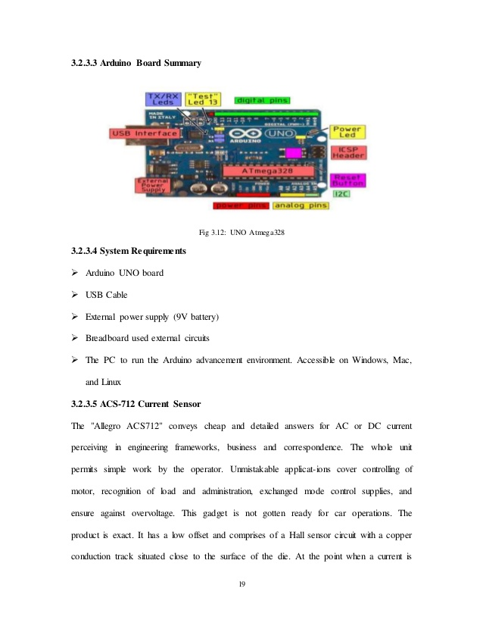
Implementation Approach
1) Arduino Module
Arduino board designs use a variety of microprocessors and controllers. The boards feature serial communications interfaces, including Universal Serial Bus (USB) on some models, which are also used for loading programs from personal computers. The microcontrollers can be programmed using C and C++programming languages. In addition to using traditional compiler tool chains, the Arduino project provides an integrated development environment (IDE) based on the Processing language project.

Slide 10
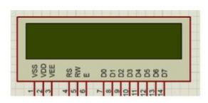
2) LCD Display Module
A liquid-crystal display (LCD) is a flat-panel display or other electronically modulated optical device that uses the light-modulating properties of liquid crystals combined with polarizer. Liquid crystals do not emit light directly, instead using a backlight or reflector to produce images in colour or monochrome. LCDs are available to display arbitrary images with low information content such as preset words, digits, and seven-segment displays, as in a digital clock. They use the same basic technology, except that arbitrary images are made from a matrix of small pixels, while other displays have larger elements.

Slide 11
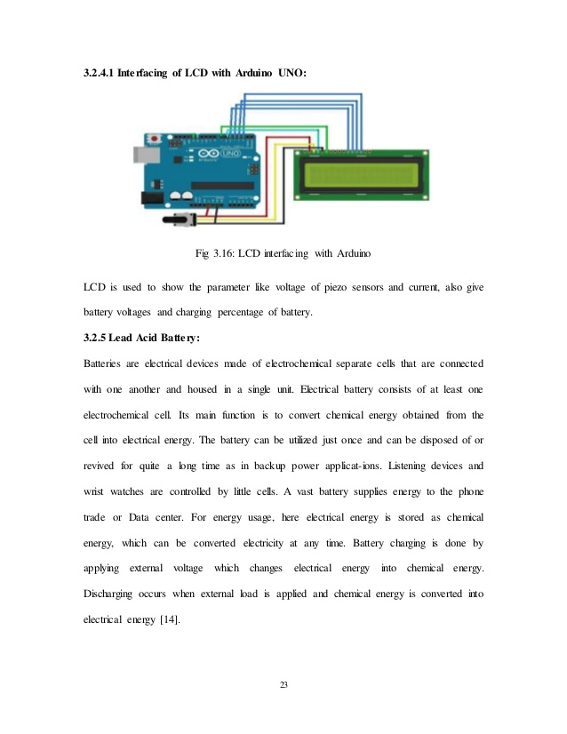
3) LCD interfacing with Arduino module
LCD is used to show parameters like voltage of piezo sensors and current, also give battery voltages and percentage of battery

Slide 12
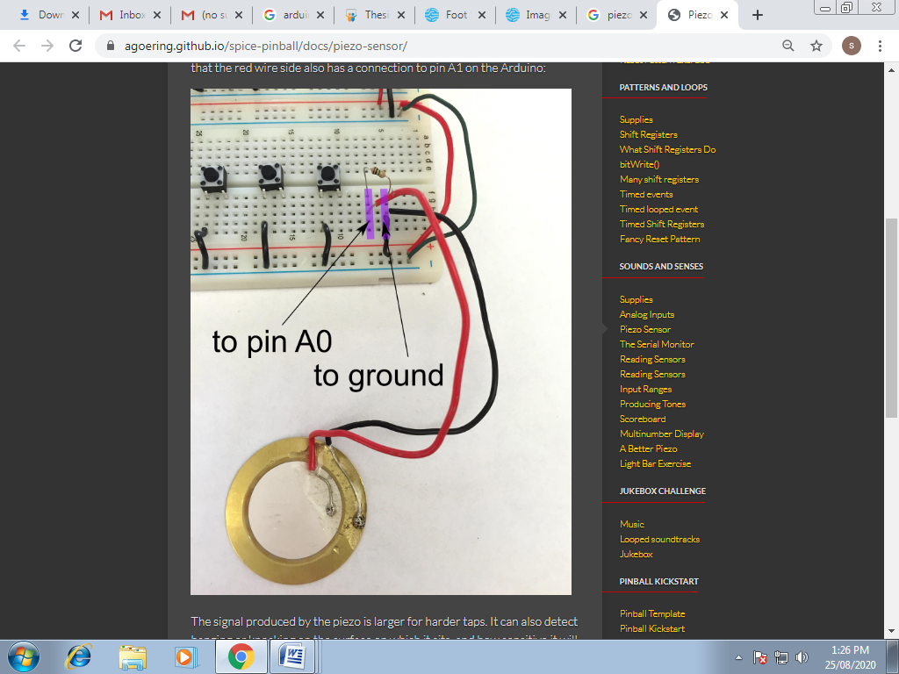
4) Piezoelectric Sensor Module
A piezoelectric sensor is made up of piezoelectric material (quartz-most used). It used to convert the mechanical stress into electrical charge. The output of the Piezoelectric Sensor is AC. The output of piezoelectric sensor or can store it into battery or other storage devices. The operating and storage temperature range is -20°C~+60°C and -30°C~+70°C respectively.

Slide 13
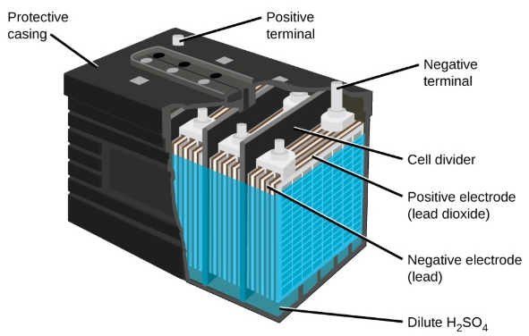
5) Lead Acid Battery Module
Battery is used to convert chemical energy into electrical energy. It comprises of various voltaic cells and every voltaic cells is composed of half cells connected in an arrangement in an electrolyte an-ions and cat-ions. The electric force between terminals of battery is known as terminal voltage and is characterized in volts. The terminal voltage of battery that is not charged or discharged is known as circuit voltage and is equivalent to the Emf of the cell. The charge limit of rechargeable battery diminishes with age and utilisation and may not be withstanding when completely charged.

Slide 14
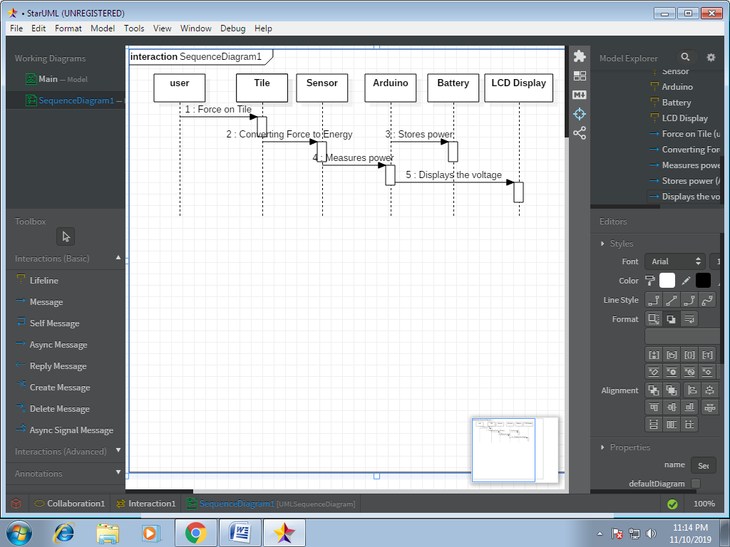
Sequence Diagram

Slide 15
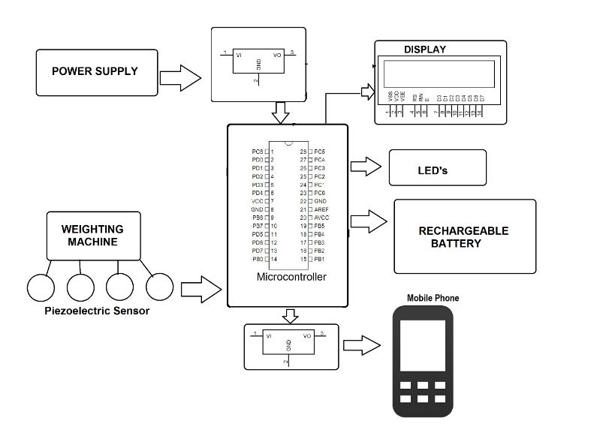
Block Diagram

Slide 16
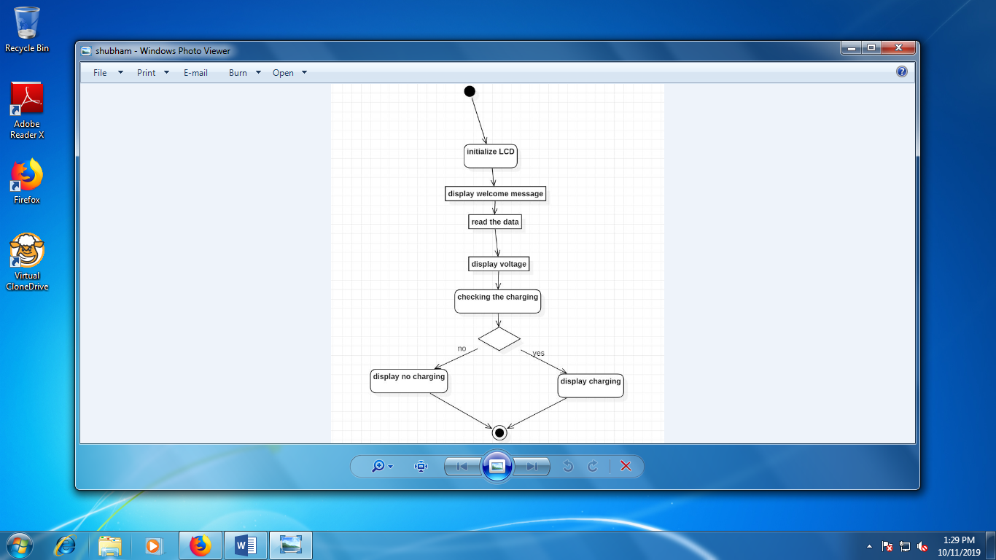
Activity Diagram

Slide 17
Future Scope
The utilization of wasted energy is very much relevant and important for highly populated countries in the world in the future.
Flooring Tiles Japan has already started experimenting with the use of the piezoelectric effect impact on generating energy. They implement a piezoelectric effect on the bus stairs. Thus every time passenger steps on the tiles; they trigger the small vibration that can be stored as energy in the battery. The flooring tiles are designed by the rubber which can absorb the vibration.
The piezoelectric sensors when used on large scale will give positive result. In India, maximum public movement is observed in railway stations, temples, and shopping malls; hence this places can be equipped with platforms with piezoelectric sensors for generation of electric power.

Slide 18
Conclusion
Footsteps are the main source of power generation. There is no need of energy from conventional source of energy and there is zero percent of pollution in this type of power generation. There is no need of any kind of power from mains and it is important to the areas, all tracks where non-conventional energy is used as electricity. The contribution of Non-conventional energy to our primary energy is 11% that is a common fact. If this project is activated it will not only add and overwhelm the energy deficit problems but this will also form global environmental change.
This technique produces electricity with the assistance of electricity components that create use of the energy of human footsteps.

Slide 19
Thank You !

